Slide 1
A Modified Approach for CSD
Simplifying the interaction; hardening the security; better supporting federation of directories

Slide 2
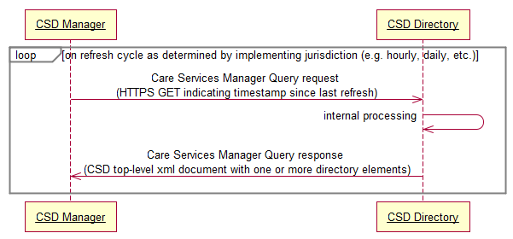
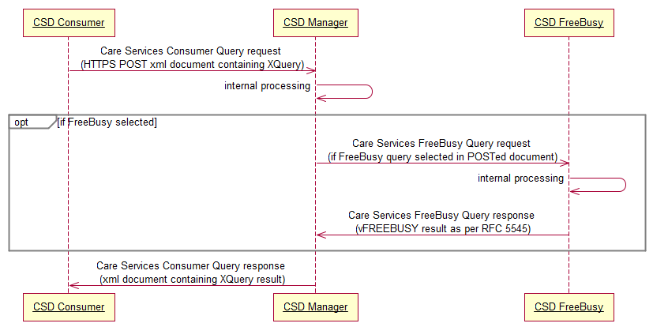

Slide 3
On a regular cycle, the CSD Manager polls each CSD Directory actor to refresh the aggregated CSD “replica” XML document it maintains.

Slide 4
https GET ?timestamp
<CSD>
<OrganizationDirectory/>
<FacilityDirectory/>
<ServiceDirectory/>
<ProviderDirectory/>
</CSD>
CSD Directory 1
“Facility” Directory
CSD Manager
<CSD>
<OrganizationDirectory/>
<FacilityDirectory/>
<ServiceDirectory/>
<ProviderDirectory/>
</CSD>
<CSD>
<OrganizationDirectory/>
<FacilityDirectory/>
<ServiceDirectory/>
<ProviderDirectory/>
</CSD>
CSD Directory 2
“Facility/Services” Directory
<CSD>
<OrganizationDirectory/>
<FacilityDirectory/>
<ServiceDirectory/>
<ProviderDirectory/>
</CSD>
<CSD>
<OrganizationDirectory/>
<FacilityDirectory/>
<ServiceDirectory/>
<ProviderDirectory/>
</CSD>
<CSD>
<OrganizationDirectory/>
<FacilityDirectory/>
<ServiceDirectory/>
<ProviderDirectory/>
</CSD>
CSD Directory 3
“Provider/Org” Directory
<CSD>
<OrganizationDirectory/>
<FacilityDirectory/>
<ServiceDirectory/>
<ProviderDirectory/>
</CSD>
CSD.xsd-compliant XML documents are returned by each Directory in response to the Manager’s poll. Each document contains the Directory’s inserted and updated records since the specified timestamp. These XML documents are merged by the Manager to create a refreshed version of the CSD replica XML document.

Slide 5
A CSD Consumer actor uses XQuery to query the CSD Manager’s replica XML document. Optional FreeBusy queries may also be executed.

Slide 6
<csdConsumerQuery>
<XQuery/>
<FreeBusy/>
</csdConsumerQuery>
<FreeBusy/>
https POST
CSD Consumer
CSD Manager
CSD FreeBusy
<XQuery/>
A CSD Consumer actor uses https POST to submit an XQuery and (optional) FreeBusy query to the CSD Manager. The XQuery is run against a CSD replica document. FreeBusy queries, if present, are sent to one or more CSD FreeBusy actors. The results are returned to the CSD Consumer inside a single response document.
<CSD>
<OrganizationDirectory/>
<FacilityDirectory/>
<ServiceDirectory/>
<ProviderDirectory/>
</CSD>
<XQueryResult/>
vFREEBUSY result

Slide 7
Some Implications…
All Directories are required to provide “fresh” content, conformant to the CSD.xsd schema, when polled.
An individual Directory may return one or more of the top level Organization, Facility, Service and Provider elements.
The Manager constructs and maintains a CSD replica XML document which Consumers may query using XQuery. Consumers do not directly access a Directory.
Queries are POSTed to the Manager by a Consumer; the result is returned as an XML document. This approach has caching implications for the Consumer.
The Manager must know the web address of every Directory.
The Manager must deconstruct inbound XQuery and FreeBusy queries and then reconstruct the results into a single response document.
The Manager’s “CSD replica” will be as “stale” as the time since the last refresh poll. FreeBusy information will not be cached by the Manager.

